Slide 1

Exploratory Data Analysis
<Virtual Internship>
<20-July-2023>

Slide 2
Agenda
Problem Statement
Approach
EDA
EDA Summary
Recommendations

Slide 3



Problem Statement
Background: XYZ, a US-based private firm, intends to explore investment opportunities in Cab Industry, which has experienced remarkable growth recently. As part of their Go-to-Market (G2M) strategy, they aim to gain comprehensive market insights before making any final decisions.
Objective : Leverage data to provide actionable business insights for XYZ firm, supporting their decision-making on which cab company to invest.

Slide 4




Approach
Data Preprocessing
Hypothesis Generation
Explorative Data Analysis
Data Visualization

Slide 5
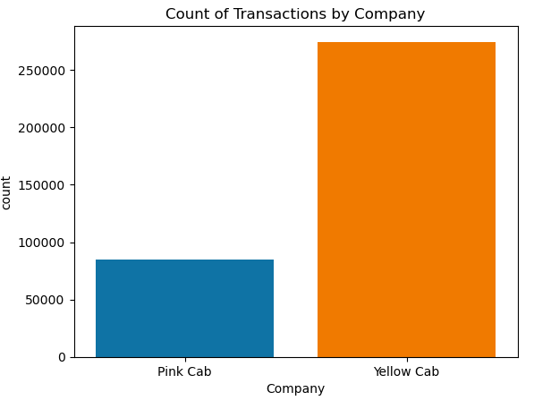
EDA
In terms of total transactions, Yellow Cab is significantly more than Pink Cab

Slide 6
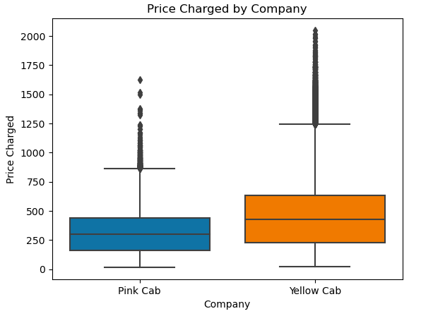
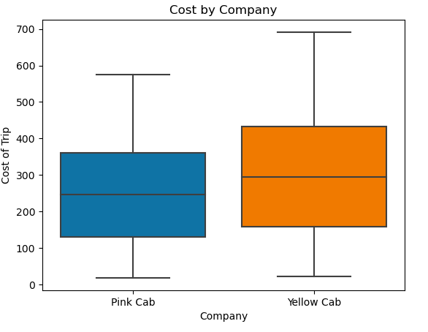
Price and Cost per trip by Company

Slide 7
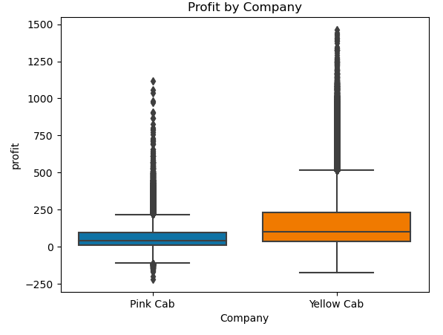
Profit by Company
Generally, Yellow Cab has better profitability than Pink Cab

Slide 8
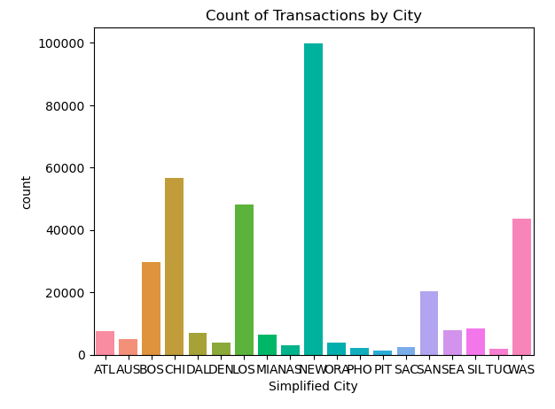
Transactions by City
Big cities have significantly more transactions.
Significant Cities:
-New York
-Los Angles
-Boston
-Washington
-Chicago
-San Diego

Slide 9
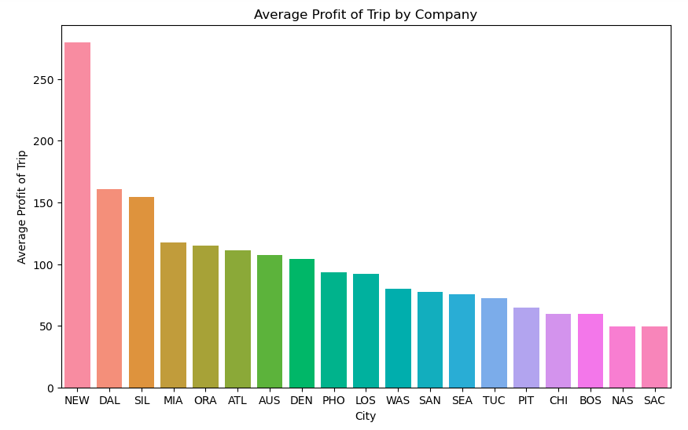
Profitability by Cities

Slide 10
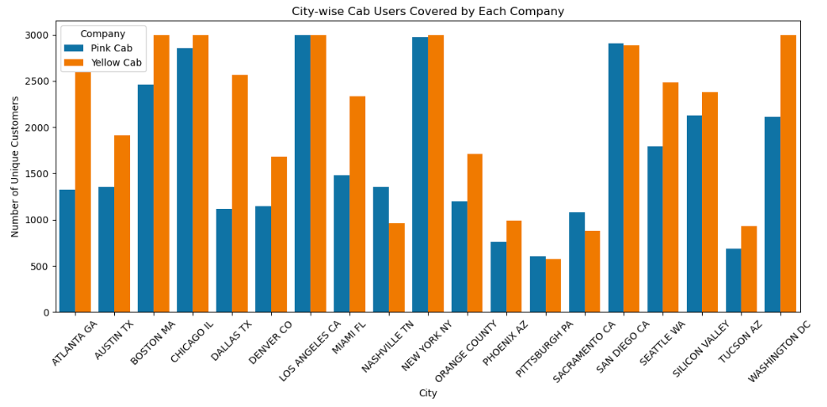



City-wise Cab Users by Company

Slide 11
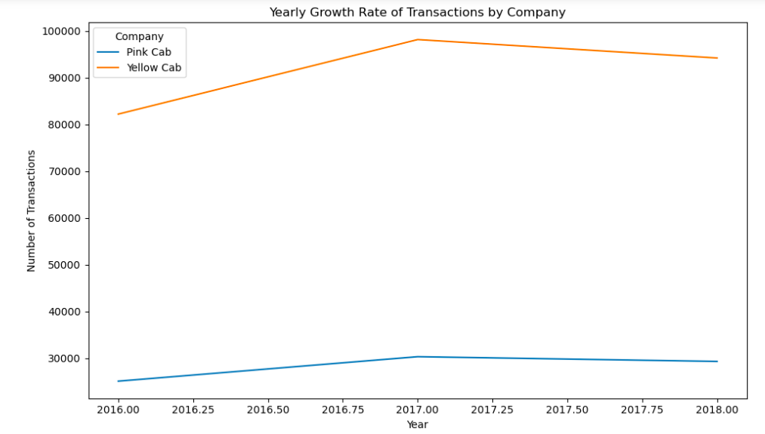
Yearly growth by Company

Slide 12
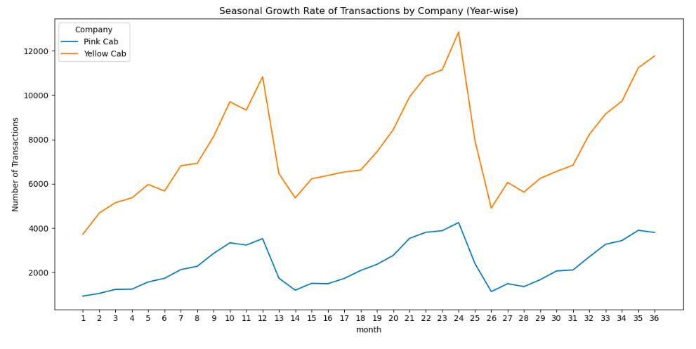
Seasonaly growth by Company

Slide 13
EDA Summary
The exploratory data analysis reveals valuable insights:
Profitability
Cities based Customer analysis
Business growth rate

Slide 14
Recommendation
We recommend Pink Cab for following reasons
Profitability: Although profitability is smaller than Yellow Cab, but it has other advantages in terms of investment.
Growth: Compared with Yellow Cab, the growth of Pink Cab is more steady and shows more potential.
City-Specific Strategies: In the most profitable cities we identified, total transactions of two companies are close.

Slide 15
Thank You

